Slide 1
AIR POLLUTION

Slide 2
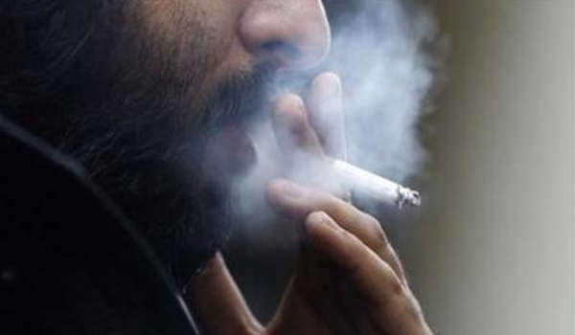
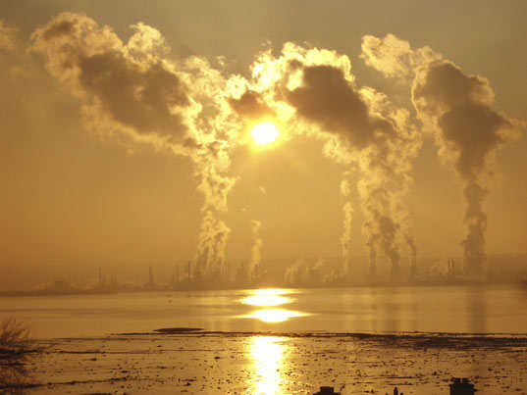
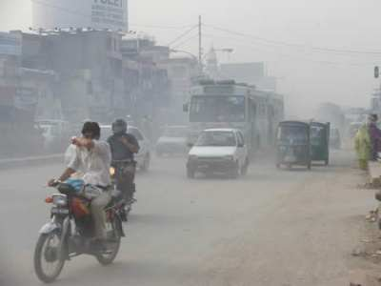
DEFINITION
occurs when the air contains gases, dust, fumes or odor in harmful amounts.
it is when concentrated gases exceed safe limits.

Slide 3
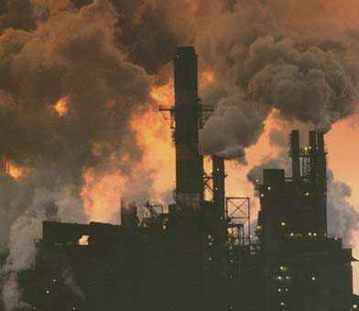
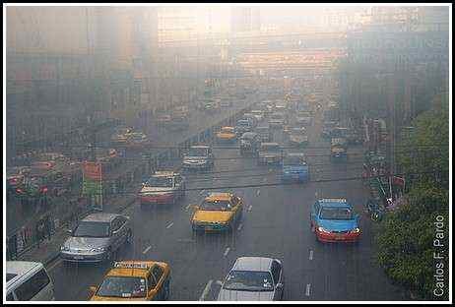
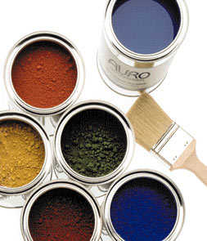
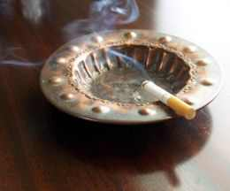
TYPES OF AIR POLLUTION
Outdoor Air Pollution
Smog
Particulates
Acid Rain
Greenhouse Gases
Indoor Air Pollution
Notes:
Outdoor Air Pollution: Each year, hundreds of millions of tons of gases and particulates pour into the atmosphere. Most of this pollution results from the burning of fuel to power motor vehicles and to heat buildings. Some air pollution also comes from business and industrial processes.
Indoor air pollution occurs when buildings with poorly designed ventilation systems trap pollutants inside.

Slide 4
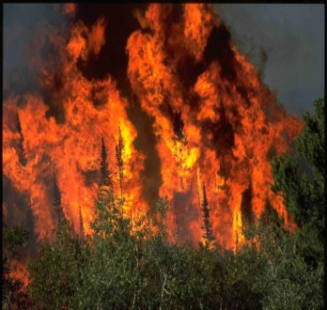
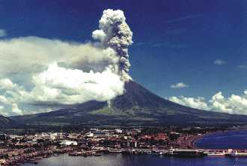
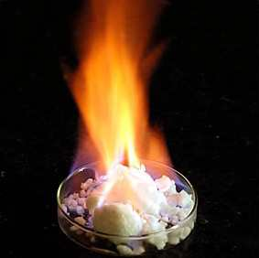
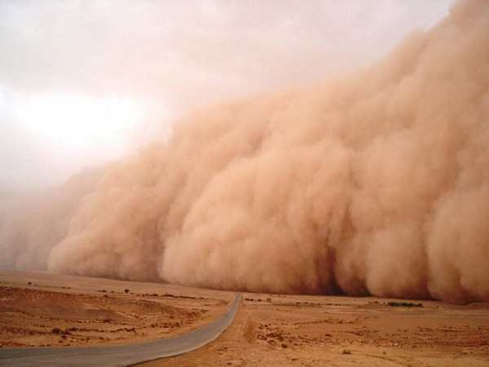
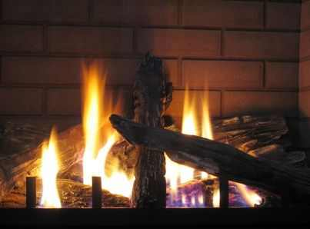
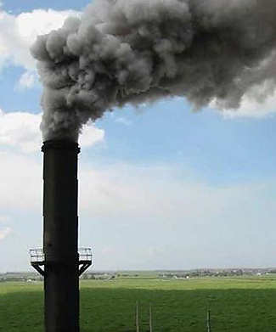
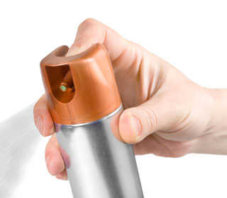
CAUSES
Natural Sources
e.g. smoke that comes from wildfires, volcanoes, methane, dust
Human Sources
e.g. power plants and automobiles, fumes, burning wood stoves, fireplaces, and furnaces

Slide 5
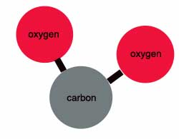
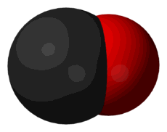
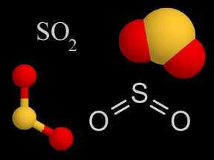
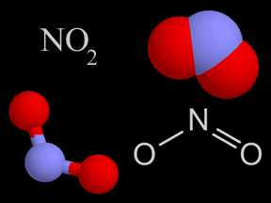
Pollutants
Carbon Dioxide
Carbon Monoxide
Sulfur Dioxide
Nitrogen Dioxide

Slide 6
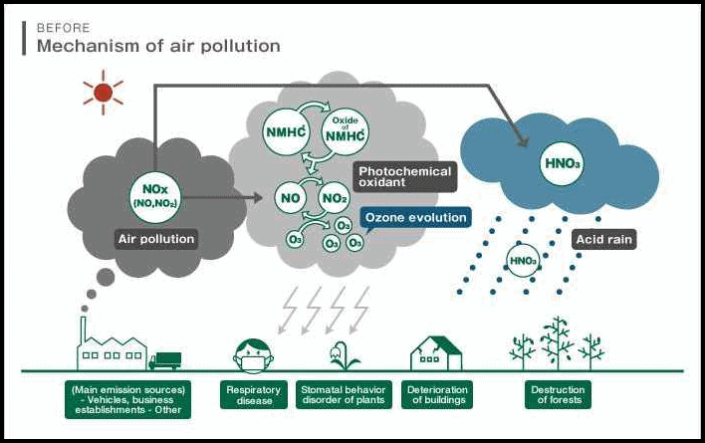
MECHANISM

Slide 7
Primary Mechanism
Formation of VOC
Biological generation of VOC
Formation of liquid aerosol droplets
Anthropomorphic generation of particulate aerosol
Biological formation of particulate aerosols
Particulate aerosol formation

Slide 8
Secondary Mechanism
Condensation
Adsorption
Nucleation

Slide 9
EFFECTS
Human Effects
e.g. diseases
Environmental Effects
Acid rain
Eutrophication
Haze
Wildlife
Ozone Depletion
Crop and forest damage
Global Climate Change

Slide 10
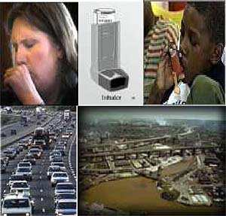
IMPACTS
Climate System
Health
Economy
Environment
Ecosystem
Forestry
Agriculture

Slide 11
MITIGATIONS
Mitigation of Air Pollution
Sustainable Development
International Conventions and Treaties
Lower Transboundary Emissions
National and International funds, Eco-Conversion
New Technologies, Recycling
Lower Combustion
Lower Emissions

Slide 12
CONCLUSION AND RECOMMENDATIONS
Air pollution has long been a serious problem in the world.
Without air, Earth would be unable to sustain life.
Spread the Word.

